Slide 1

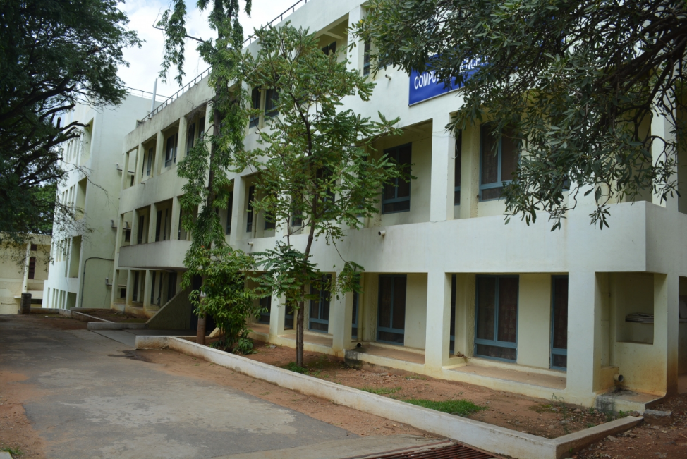
Department of Computer
Science & Engineering
CN: Transmissin Modes
Dr. Minal Moharir
Subject Ranking – Computer Science
Subject Ranking – Computer Science

Slide 2
Asynchronous Transmission
Characteristics:
Timing: Each data byte is sent independently, with its own start and stop bits. There is no continuous timing signal between sender and receiver.
Synchronization: The receiver synchronizes with the sender at the start of each byte, using the start bit to recognize the beginning of a new data byte.
Data Integrity: Start and stop bits ensure that each byte is correctly framed, but there may be gaps or variations in timing between bytes.
Overhead: Higher overhead due to additional start and stop bits for each byte.
Subject Ranking – Computer Science
Subject Ranking – Computer Science

Slide 3
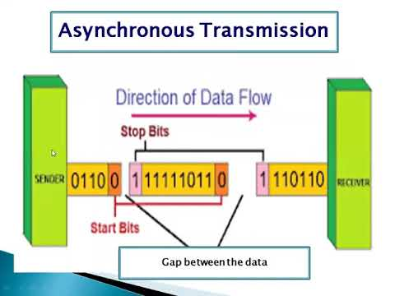
Asynchronous Transmission
Subject Ranking – Computer Science
Subject Ranking – Computer Science

Slide 4
Asynchronous Transmission
Applications:
Commonly used in serial communication, such as RS-232.
Suitable for applications where data is sent at irregular intervals, like keyboard inputs or sensor data.
Example:
Typing on a keyboard, where each keystroke generates a character sent independently.
.
Subject Ranking – Computer Science
Subject Ranking – Computer Science

Slide 5
Synchronous Transmission
Characteristics:
Timing: Data is sent in a continuous stream, synchronized by a shared clock signal between sender and receiver.
Synchronization: Both sender and receiver use the clock signal to stay in sync, ensuring precise timing for data bits.
Data Integrity: Synchronization allows for efficient and reliable data transfer, with lower overhead than asynchronous transmission.
Overhead: Lower overhead as no start and stop bits are needed, though synchronization characters may be used.
.
Subject Ranking – Computer Science
Subject Ranking – Computer Science

Slide 6
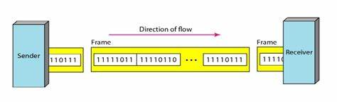
Synchronous Transmission
Subject Ranking – Computer Science
Subject Ranking – Computer Science

Slide 7
Synchronous Transmission
Applications:
Used in high-speed communication systems where continuous data flow is required, such as Ethernet, fiber optics, and some telecommunications protocols.
Suitable for applications needing high data transfer rates and minimal latency.
Example:
Data transfer over a network using Ethernet, where data is sent in frames with synchronization.
.
Subject Ranking – Computer Science
Subject Ranking – Computer Science

Slide 8
Isochronous Transmission
Characteristics:
Timing: Data is sent at regular intervals, ensuring a consistent timing relationship between sender and receiver.
Synchronization: Combines aspects of both synchronous and asynchronous transmission, focusing on timing consistency rather than exact synchronization.
Data Integrity: Ensures that data is delivered at consistent time intervals, which is crucial for real-time applications but may tolerate some errors in data integrity.
Overhead: Similar to synchronous transmission in terms of efficiency but designed for time-sensitive data.
Subject Ranking – Computer Science
Subject Ranking – Computer Science

Slide 9
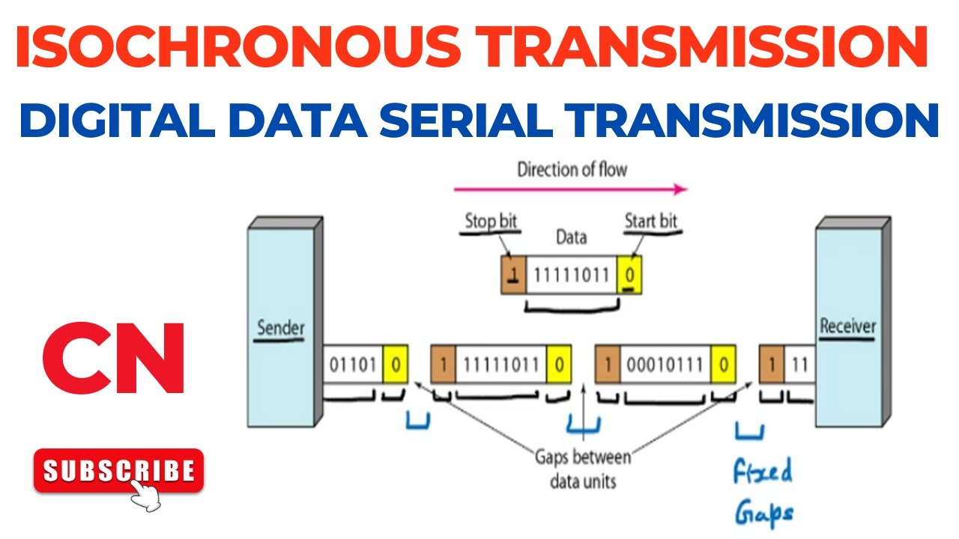
Isochronous Transmission
Subject Ranking – Computer Science
Subject Ranking – Computer Science

Slide 10
Isochronous Transmission
Applications:
Primarily used in real-time communication systems where timely delivery is critical, such as audio and video streaming, VoIP, and industrial control systems.
Suitable for applications where maintaining timing consistency is more important than occasional data errors.
Example:
Video conferencing, where maintaining a smooth and continuous flow of audio and video data is crucial for user experience.
Subject Ranking – Computer Science
Subject Ranking – Computer Science

Slide 11
Summary of Key Differences
Asynchronous Transmission: Data is sent one byte at a time, each with its own start and stop bits. Used for irregular, intermittent data transfer.
Synchronous Transmission: Data is sent in a continuous stream with synchronization provided by a shared clock signal. Used for high-speed, continuous data transfer.
Isochronous Transmission: Data is sent at regular intervals, ensuring consistent timing. Used for real-time applications where timing is critical.
Subject Ranking – Computer Science
Subject Ranking – Computer Science

